Slide 1
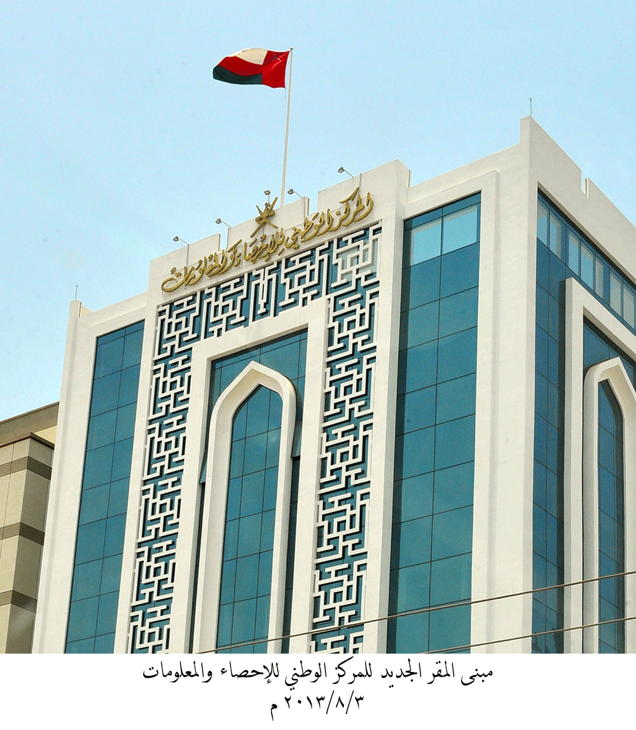
Khalifa Al Barwani
Acting CEO
Kbarwani@ncsi.gov.om
National Centre for Statistics and Information (NCSI)
Modernization of Management and
Structure of Statistical Organization

Slide 2
Country profile
Outline Of Presentation
Statistics History in Oman
Vision, Mission & Values
Organization structure
05
Strategic goals

Slide 3
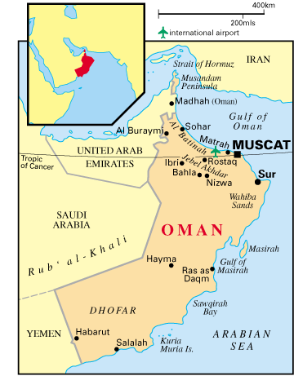
Country profile
3,934,503 Total Population for October 2013
44.2% Percentage of Expatriate Population
30,033.6 Gross Domestic Product Prices for 2012 (O.R Million)
Information about Oman updated live, and straight to your phone
One Omani Rial = 2.6 U.S

Slide 4
Statistics History in Oman
General Directorate of Social & Economic Statistics and Information Center
Ministry of Development and Ministry of National Economic
Statistics Department Ministry of Development
1974
1977
1994
2012
General Directorate for National Statistics
Development Council
NCSI
His Majesty Sultan Qaboos Bin Said issued the Royal Decree No. 31/2012 on 27 May 2012 to establish the National Center for Statistics and Information (NCSI).

Slide 5
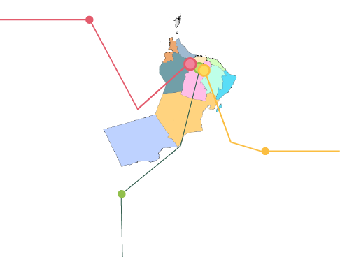
Vision, Mission & Values
Vision
To provide high-quality statistics and objective, responsive information services in accordance with international standards and best practices, contributing to the social and economic developments of Oman.
Our Staff
Maintain our commitment to privacy
Our leadership
Professional is our way
Transparency Our approach
Partnership
Our Users
Values
To develop and maintain a sound and reputable National Statistical System
To provide adequate, relevant, reliable and timely statistics.
To promote a culture of statistical awareness
Mission

Slide 6
Organization structure for Oman’s National Center for Statistics and Information
NCSI Board
CEO
Training Center and Development of
Human Resources
DG of Information
DG of Population and Social Statistics
CEO's Office
Standing Committees of Statistics Office
Strategies, Standards and Quality
DG of Administration and Finance Affairs
DG of Information
Technology
DG of Spatial Statistics
DG of Economic Statistics
DG of National Spatial Data infrastructure (NSDI)

Slide 7
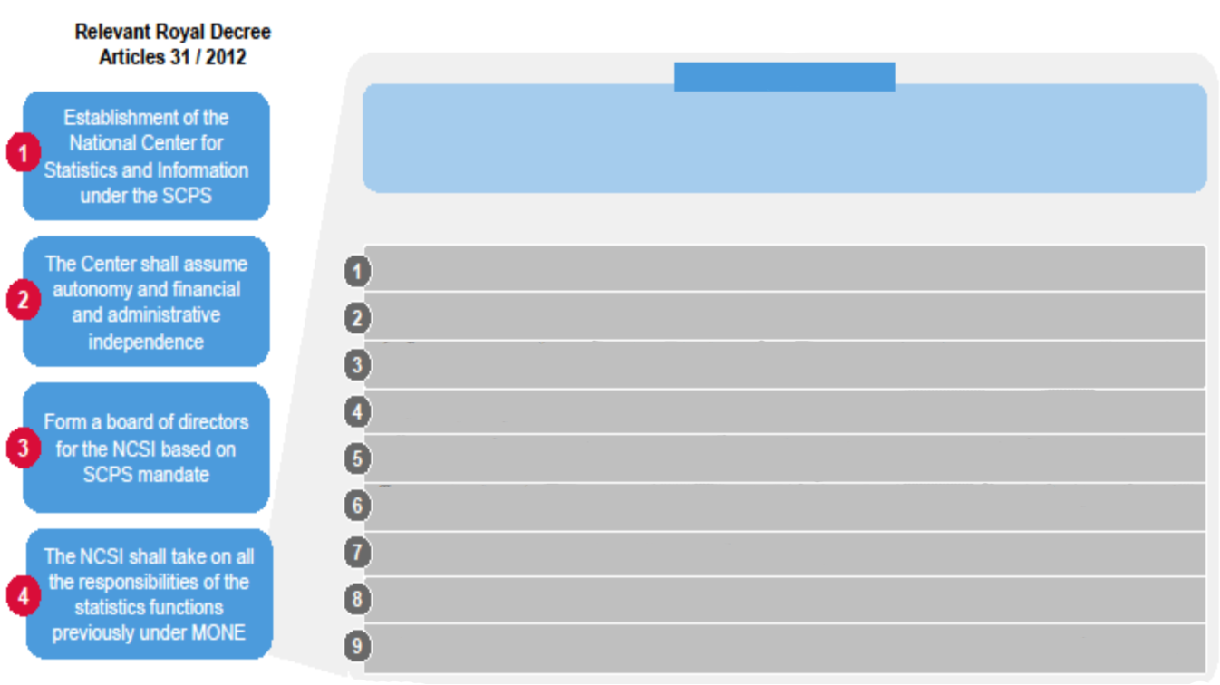
Responsibilities and Functions of NCSI
a long term national strategy for statistical development
setting quality and operational standards
implementing statistical programs in NCSI
developing statistical programs in PGUs
quality management of statistics produced by PGUs
undertaking research and analytical studies to generate value adding information
building information repositories
providing one-stop information services
planning statistical capability building

Slide 8
05
Strategic goals
H
Communications
Staff and managers are well informed, know the organization and their role with
regards to it
0-2
H
Human Resources, including Recruitment
Staff fully supported in the personal ‘hierarchy of needs’
0-2
H
Training and development
The establishment of a training centre and an organisational capacity to know
and meet the training needs of all staff working in official statistics
0-2
H
Official Statistical Service, Oman
Offering a well recognized and highly respected official statistical service to
Oman.
3-5
H
Oman National Spatial Data Infrastructure
ONSDI program will establish a standardized, accurate and up-to-dated GIS data inventory with procedures to continuously updating the data
3-5

Slide 9
H
Information Technology
To fully exploit IT as a catalyst for achievement and innovation
3-5
H
Data Management
Technical capacity (Methodological, Research, Spatial analyses, IT etc) to
understand, handle and protect the information entrusted to us.
3-5
H
Data Collection Tools
Modern, efficient and effective methods for the collection of information
0-2
H
Knowledge – Transfer
Strong in core/key disciplines i.e. statistical, methodological, research, GIS, analyses and IT
3-5
H
Administrative Data
Minimize burden and maximize the use of available data through the sourcing of
data collected for other than statistical purpose
3-5
H
Production Process
Fully documented, quality assured processes for the production of our outputs
3-5

Slide 10
H
Partnerships
Strong, mutually beneficial partnerships inside and outside Oman that aid in our
function as a NIO. Actively twin with ‘senior’ and ‘junior’ partners
3-5
H
Quality Management
Know what quality means and how to build, measure and report it (incl. KPIs)
in our inputs, processes and outputs.
3-5
M
User and societal relations
Open channels exist to ensure user input and understanding of our statistical and informational priorities.
0-2
M
Knowledge – Share
Know suppliers and users; who they are and what they need
3-5
M
Knowledge – Capture
Have the systems and processes to ensure that knowledge is held and
retained in the organization
3-5
M
Branding and Marketing
Products of the Centre are known and widely used and the organisation’s
quality is acknowledged.
3-5

Slide 11
M
Dissemination
Data is understood and accessible through modern methods
3-5
M
Business Continuity
NCSI has processes in place that allows it to function and recover systems and
information should disaster strike
6-12
M
Stakeholder engagement
Stakeholders understand and support their stake in Omani official statistics and information
3-5
L
Portfolio of statistical and informational products
Know and meet users’ needs while balancing the priorities of time and cost
6-12
L
International Cooperation
Organisation is respected for its’ integrity and consulted by other NSIs and agencies
6-12

Slide 12
Thanks
谢 谢

